Slide 1
Linear Models for Regression
Dr Abdulrahman Altahhan
Unit 4

Slide 2
Datasets in univariate setting
With univariate our data looks like this
x | t
0.00632 | 24
0.02731 | 21.6
0.02729 | 34.7
0.03237 | 33.4
0.06905 | 36.2
0.02985 | 28.7
0.08829 | 22.9
0.14455 | 27.1
0.21124 | 16.5
0.17004 | 18.9
0.22489 | 15
0.11747 | 18.9
0.09378 | 21.7
0.62976 | 20.4
0.63796 | 18.2
0.62739 | 19.9
1.05393 | 23.1
0.7842 | 17.5
0.80271 | 20.2
0.7258 | 18.2

Slide 3


Datasets in univariate setting
$$x_{3}$$
$$y_{3}$$
x₁ | t
0.00632 | 24
0.02731 | 21.6
0.02729 | 34.7
0.03237 | 33.4
0.06905 | 36.2
0.02985 | 28.7
0.08829 | 22.9
0.14455 | 27.1
0.21124 | 16.5
0.17004 | 18.9
0.22489 | 15
0.11747 | 18.9
0.09378 | 21.7
0.62976 | 20.4
0.63796 | 18.2
0.62739 | 19.9
1.05393 | 23.1
0.7842 | 17.5
0.80271 | 20.2
0.7258 | 18.2

Slide 4
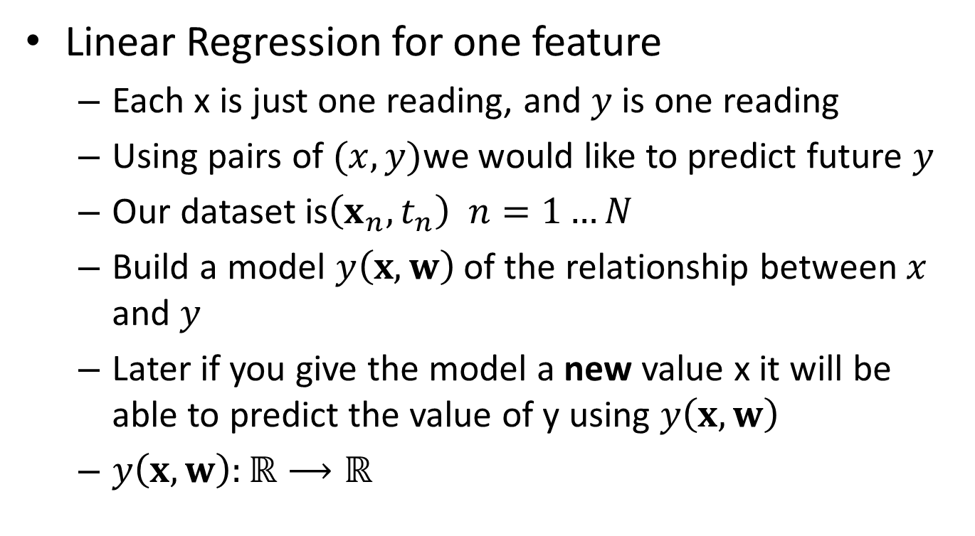
Linear Regression: univariate
Linear Regression for one feature
Each x is just one reading, and $y$ is one reading
Using pairs of $(x,y)$we would like to predict future $y$
Our dataset is$\left(x_{n},t_{n}\right) n=1…N$
Build a model $y\left(x,w\right)$ of the relationship between $x$ and $y$
Later if you give the model a new value x it will be able to predict the value of y using $y\left(x,w\right)$
$y\left(x,w\right):ℝ⟶ℝ$

Slide 5

Hypothesis (Univariate Model)
Our linear model took the form
$y\left(x,w\right)=w_{0}+w_{1}x$

Slide 6
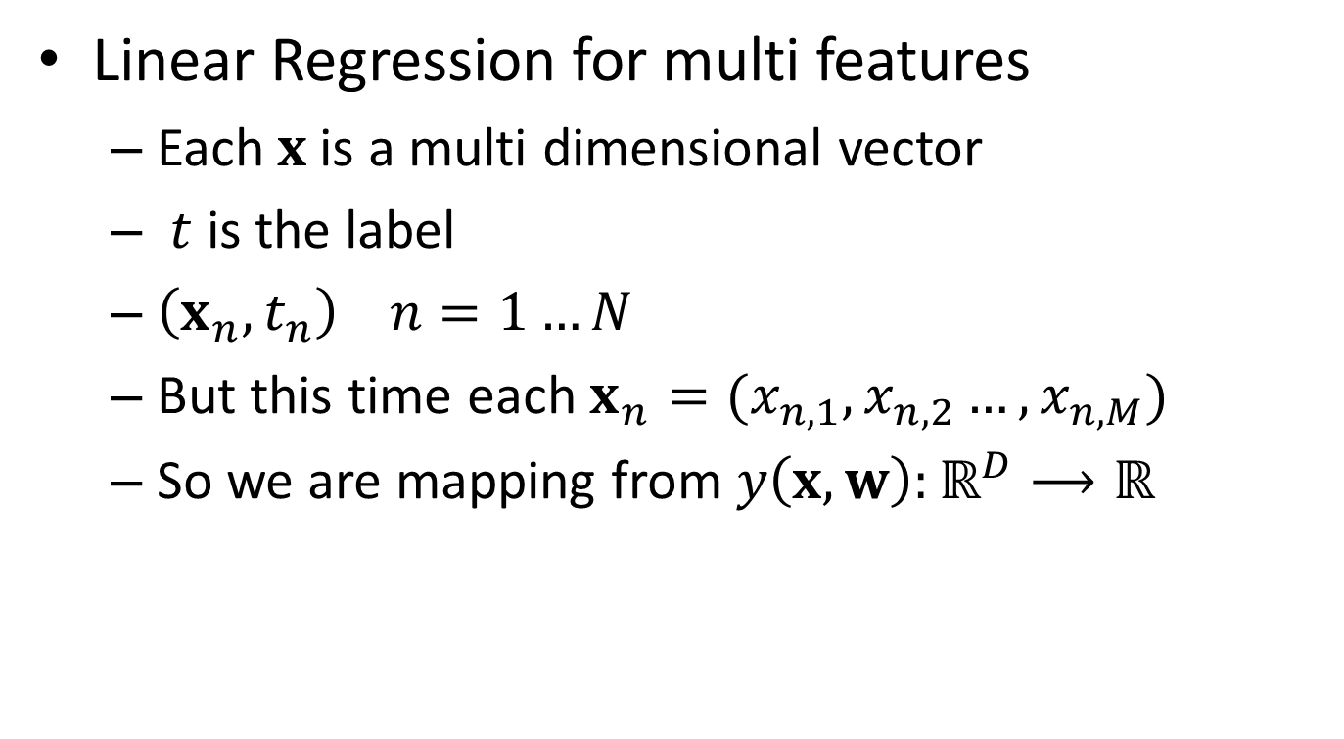
Linear Regression: Multivariate
Linear Regression for multi features
Each$x$is a multi dimensional vector
$t$ is the label
$\left(x_{n},t_{n}\right) n=1…N$
But this time each $x_{n}=(x_{n,1},x_{n,2}…,x_{n,M})$
So we are mapping from ${y\left(x,w\right):ℝ}^{D}⟶ℝ$

Slide 7


Datasets in univariate setting
$$x_{2}$$
$$t_{2}$$
x | t
0.00632 | 24
0.02731 | 21.6
0.02729 | 34.7
0.03237 | 33.4
0.06905 | 36.2
0.02985 | 28.7
0.08829 | 22.9
0.14455 | 27.1
0.21124 | 16.5
0.17004 | 18.9
0.22489 | 15
0.11747 | 18.9
0.09378 | 21.7
0.62976 | 20.4
0.63796 | 18.2
0.62739 | 19.9
1.05393 | 23.1
0.7842 | 17.5
0.80271 | 20.2
0.7258 | 18.2

Slide 8



Datasets in Multivariate setting
$$x_{2}$$
$$x_{2,5}$$
$$t_{2}$$
x₁ | x₂ | x₃ | x₄ | x₅ | x₆ | x₇ | x₈ | x₉ | x₁₀ | x₁₁ | x₁₂ | x₁₃ | y
0.00632 | 18 | 2.31 | 0 | 0.538 | 6.575 | 65.2 | 4.09 | 1 | 296 | 15.3 | 396.9 | 4.98 | 24
0.02731 | 0 | 7.07 | 0 | 0.469 | 6.421 | 78.9 | 4.9671 | 2 | 242 | 17.8 | 396.9 | 9.14 | 21.6
0.02729 | 0 | 7.07 | 0 | 0.469 | 7.185 | 61.1 | 4.9671 | 2 | 242 | 17.8 | 392.83 | 4.03 | 34.7
0.03237 | 0 | 2.18 | 0 | 0.458 | 6.998 | 45.8 | 6.0622 | 3 | 222 | 18.7 | 394.63 | 2.94 | 33.4
0.06905 | 0 | 2.18 | 0 | 0.458 | 7.147 | 54.2 | 6.0622 | 3 | 222 | 18.7 | 396.9 | 5.33 | 36.2
0.02985 | 0 | 2.18 | 0 | 0.458 | 6.43 | 58.7 | 6.0622 | 3 | 222 | 18.7 | 394.12 | 5.21 | 28.7
0.08829 | 12.5 | 7.87 | 0 | 0.524 | 6.012 | 66.6 | 5.5605 | 5 | 311 | 15.2 | 395.6 | 12.43 | 22.9
0.14455 | 12.5 | 7.87 | 0 | 0.524 | 6.172 | 96.1 | 5.9505 | 5 | 311 | 15.2 | 396.9 | 19.15 | 27.1
0.21124 | 12.5 | 7.87 | 0 | 0.524 | 5.631 | 100 | 6.0821 | 5 | 311 | 15.2 | 386.63 | 29.93 | 16.5
0.17004 | 12.5 | 7.87 | 0 | 0.524 | 6.004 | 85.9 | 6.5921 | 5 | 311 | 15.2 | 386.71 | 17.1 | 18.9
0.22489 | 12.5 | 7.87 | 0 | 0.524 | 6.377 | 94.3 | 6.3467 | 5 | 311 | 15.2 | 392.52 | 20.45 | 15
0.11747 | 12.5 | 7.87 | 0 | 0.524 | 6.009 | 82.9 | 6.2267 | 5 | 311 | 15.2 | 396.9 | 13.27 | 18.9
0.09378 | 12.5 | 7.87 | 0 | 0.524 | 5.889 | 39 | 5.4509 | 5 | 311 | 15.2 | 390.5 | 15.71 | 21.7
0.62976 | 0 | 8.14 | 0 | 0.538 | 5.949 | 61.8 | 4.7075 | 4 | 307 | 21 | 396.9 | 8.26 | 20.4
0.63796 | 0 | 8.14 | 0 | 0.538 | 6.096 | 84.5 | 4.4619 | 4 | 307 | 21 | 380.02 | 10.26 | 18.2
0.62739 | 0 | 8.14 | 0 | 0.538 | 5.834 | 56.5 | 4.4986 | 4 | 307 | 21 | 395.62 | 8.47 | 19.9
1.05393 | 0 | 8.14 | 0 | 0.538 | 5.935 | 29.3 | 4.4986 | 4 | 307 | 21 | 386.85 | 6.58 | 23.1
0.7842 | 0 | 8.14 | 0 | 0.538 | 5.99 | 81.7 | 4.2579 | 4 | 307 | 21 | 386.75 | 14.67 | 17.5
0.80271 | 0 | 8.14 | 0 | 0.538 | 5.456 | 36.6 | 3.7965 | 4 | 307 | 21 | 288.99 | 11.69 | 20.2
0.7258 | 0 | 8.14 | 0 | 0.538 | 5.727 | 69.5 | 3.7965 | 4 | 307 | 21 | 390.95 | 11.28 | 18.2

Slide 9
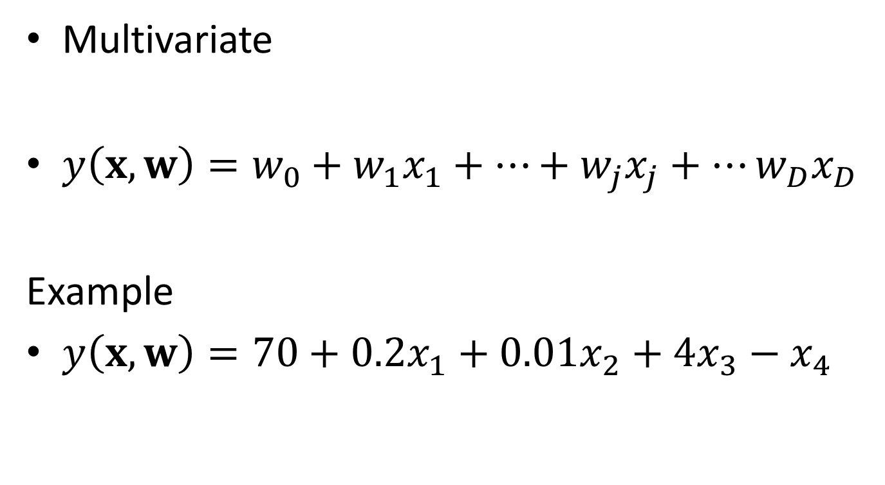
Hypothesis (Multivariate Model)
Multivariate
$y\left(x,w\right)=w_{0}+w_{1}x_{1}+…+w_{j}x_{j}+…w_{D}x_{D}$
Example
$y\left(x,w\right)=70+0.2x_{1}+0.01x_{2}+4x_{3}−$ $x_{4}$

Slide 10
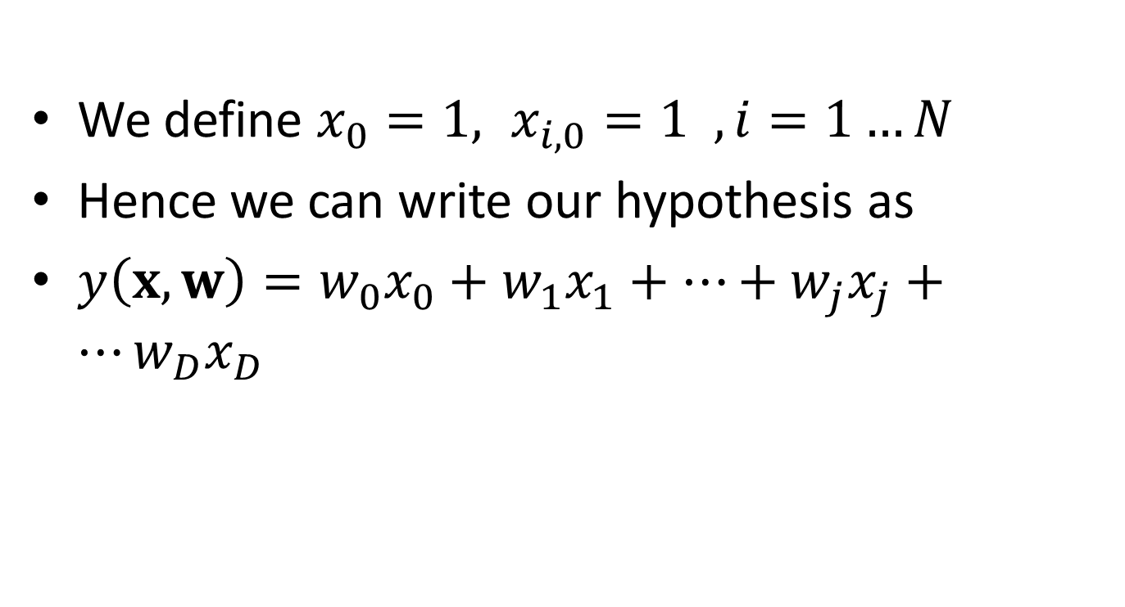
Hypothesis (Model)
We define $x_{0}=1, x_{i,0}=1 , i=1…N$
Hence we can write our hypothesis as
$y\left(x,w\right)=w_{0}x_{0}+w_{1}x_{1}+…+w_{j}x_{j}+…w_{D}x_{D}$

Slide 11
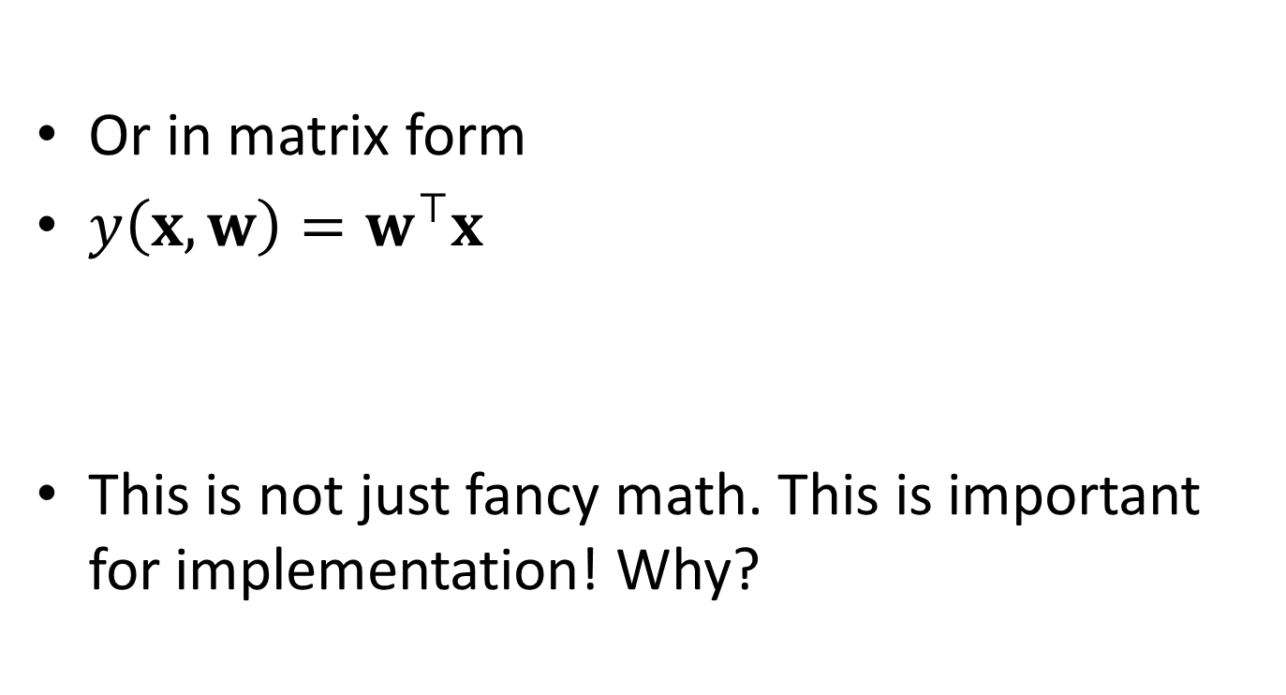
Linear Regression Hypothesis (Model)
Or in matrix form
$y\left(x,w\right)=w^{⊤}x$
This is not just fancy math. This is important for implementation! Why?

Slide 12
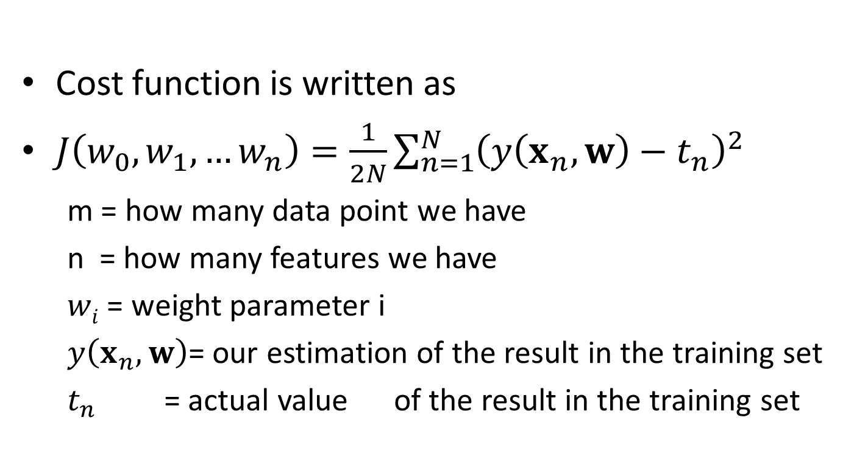
Linear Regression Cost Function
Cost function is written as
$J\left(w_{0},w_{1},…w_{n}\right)=\frac{1}{2N}\sum_{n=1}^{N}{{\left(y\left(x_{n},w\right)−t_{n}\right)}^{2}}$
m = how many data point we have
n = how many features we have
$wi$ = weight parameter i
$y\left(x_{n},w\right)$= our estimation of the result in the training set
$t_{n}$ = actual value of the result in the training set

Slide 13
Question
Try to see why we can use higher order polynomials for the x’s in linear regression and this is will not change the linearity of our model

Slide 14
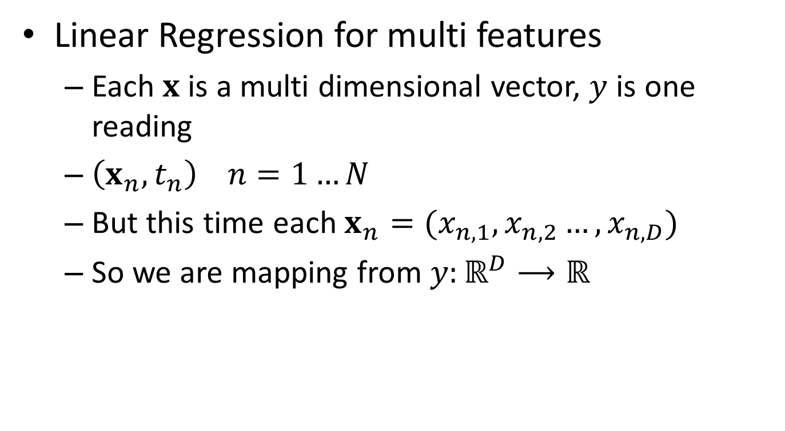
Linear Regression: univariate and multivariate
Linear Regression for multi features
Each $x$ is a multi dimensional vector, $y$ is one reading
$\left(x_{n},t_{n}\right) n=1…N$
But this time each $x_{n}=(x_{n,1},x_{n,2}…,x_{n,D})$
So we are mapping from ${y:ℝ}^{D}⟶ℝ$

Slide 15



Datasets in Multivariate setting
$$x_{3}$$
$$x_{3,5}$$
$$t_{3}$$
x₁ | x₂ | x₃ | x₄ | x₅ | x₆ | x₇ | x₈ | x₉ | x₁₀ | x₁₁ | x₁₂ | x₁₃ | y
0.00632 | 18 | 2.31 | 0 | 0.538 | 6.575 | 65.2 | 4.09 | 1 | 296 | 15.3 | 396.9 | 4.98 | 24
0.02731 | 0 | 7.07 | 0 | 0.469 | 6.421 | 78.9 | 4.9671 | 2 | 242 | 17.8 | 396.9 | 9.14 | 21.6
0.02729 | 0 | 7.07 | 0 | 0.469 | 7.185 | 61.1 | 4.9671 | 2 | 242 | 17.8 | 392.83 | 4.03 | 34.7
0.03237 | 0 | 2.18 | 0 | 0.458 | 6.998 | 45.8 | 6.0622 | 3 | 222 | 18.7 | 394.63 | 2.94 | 33.4
0.06905 | 0 | 2.18 | 0 | 0.458 | 7.147 | 54.2 | 6.0622 | 3 | 222 | 18.7 | 396.9 | 5.33 | 36.2
0.02985 | 0 | 2.18 | 0 | 0.458 | 6.43 | 58.7 | 6.0622 | 3 | 222 | 18.7 | 394.12 | 5.21 | 28.7
0.08829 | 12.5 | 7.87 | 0 | 0.524 | 6.012 | 66.6 | 5.5605 | 5 | 311 | 15.2 | 395.6 | 12.43 | 22.9
0.14455 | 12.5 | 7.87 | 0 | 0.524 | 6.172 | 96.1 | 5.9505 | 5 | 311 | 15.2 | 396.9 | 19.15 | 27.1
0.21124 | 12.5 | 7.87 | 0 | 0.524 | 5.631 | 100 | 6.0821 | 5 | 311 | 15.2 | 386.63 | 29.93 | 16.5
0.17004 | 12.5 | 7.87 | 0 | 0.524 | 6.004 | 85.9 | 6.5921 | 5 | 311 | 15.2 | 386.71 | 17.1 | 18.9
0.22489 | 12.5 | 7.87 | 0 | 0.524 | 6.377 | 94.3 | 6.3467 | 5 | 311 | 15.2 | 392.52 | 20.45 | 15
0.11747 | 12.5 | 7.87 | 0 | 0.524 | 6.009 | 82.9 | 6.2267 | 5 | 311 | 15.2 | 396.9 | 13.27 | 18.9
0.09378 | 12.5 | 7.87 | 0 | 0.524 | 5.889 | 39 | 5.4509 | 5 | 311 | 15.2 | 390.5 | 15.71 | 21.7
0.62976 | 0 | 8.14 | 0 | 0.538 | 5.949 | 61.8 | 4.7075 | 4 | 307 | 21 | 396.9 | 8.26 | 20.4
0.63796 | 0 | 8.14 | 0 | 0.538 | 6.096 | 84.5 | 4.4619 | 4 | 307 | 21 | 380.02 | 10.26 | 18.2
0.62739 | 0 | 8.14 | 0 | 0.538 | 5.834 | 56.5 | 4.4986 | 4 | 307 | 21 | 395.62 | 8.47 | 19.9
1.05393 | 0 | 8.14 | 0 | 0.538 | 5.935 | 29.3 | 4.4986 | 4 | 307 | 21 | 386.85 | 6.58 | 23.1
0.7842 | 0 | 8.14 | 0 | 0.538 | 5.99 | 81.7 | 4.2579 | 4 | 307 | 21 | 386.75 | 14.67 | 17.5
0.80271 | 0 | 8.14 | 0 | 0.538 | 5.456 | 36.6 | 3.7965 | 4 | 307 | 21 | 288.99 | 11.69 | 20.2
0.7258 | 0 | 8.14 | 0 | 0.538 | 5.727 | 69.5 | 3.7965 | 4 | 307 | 21 | 390.95 | 11.28 | 18.2

Slide 16
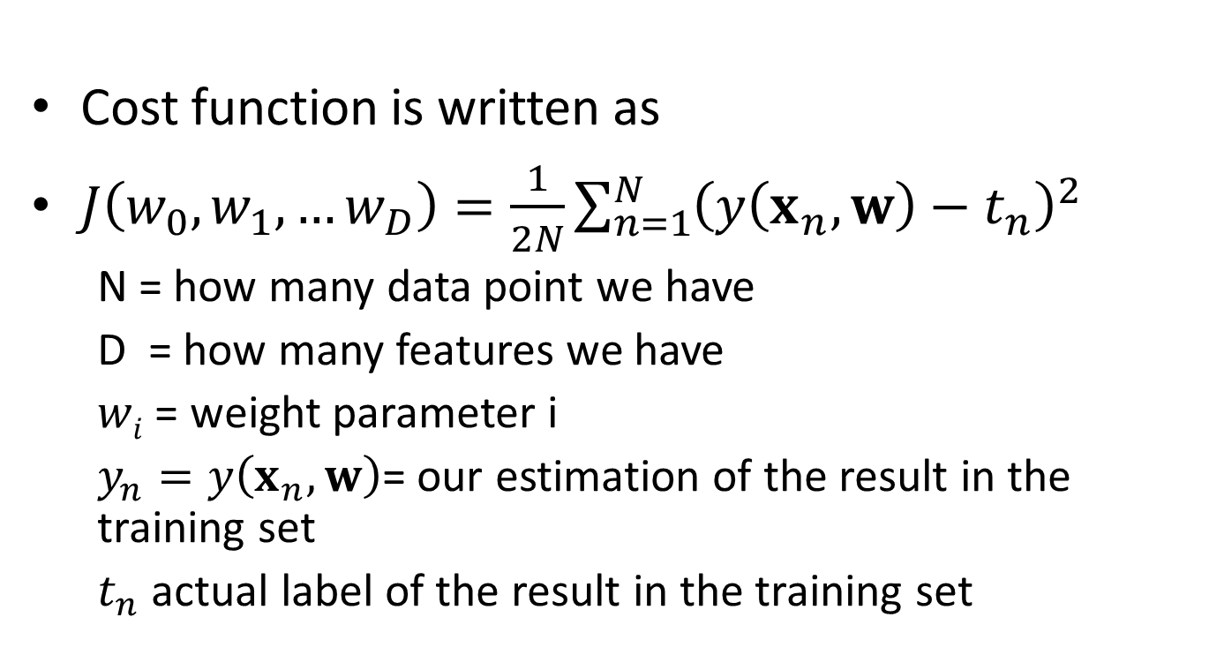
Linear Regression Cost Function
Cost function is written as
$J\left(w_{0},w_{1},…w_{D}\right)=\frac{1}{2N}\sum_{n=1}^{N}{{\left(y\left(x_{n},w\right)−t_{n}\right)}^{2}}$
N = how many data point we have
D = how many features we have
$wi$ = weight parameter i
$y_{n}=y\left(x_{n},w\right)$= our estimation of the result in the training set
$t_{n}$ actual label of the result in the training set

Slide 17
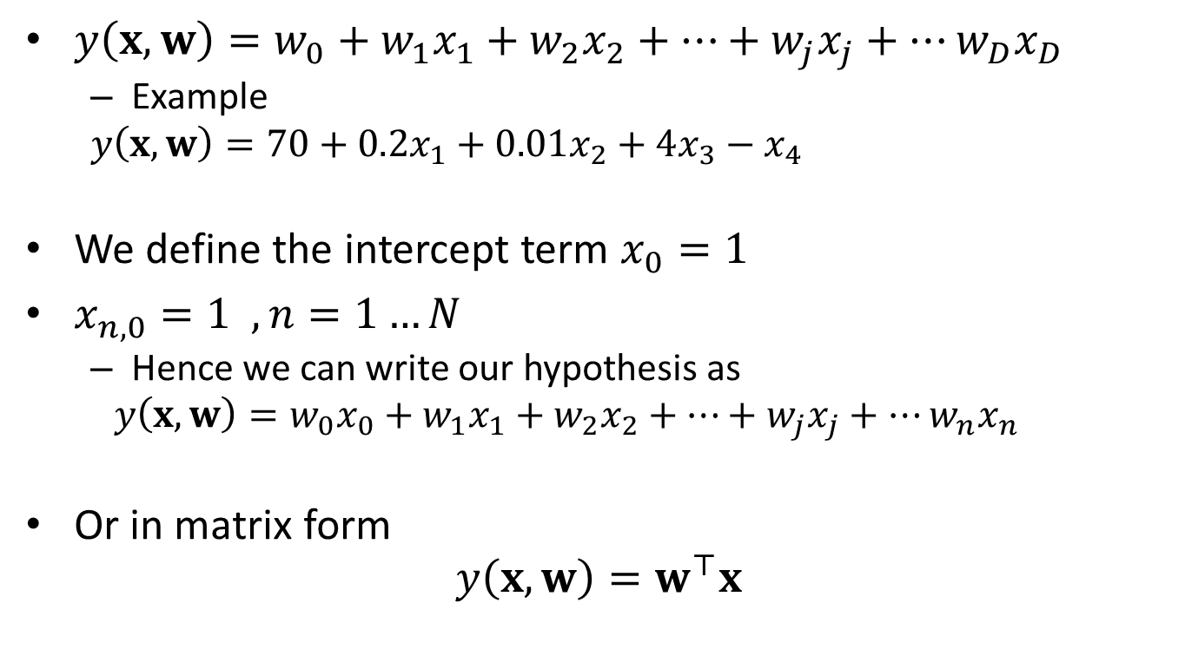
Hypothesis (Model)
$y\left(x,w\right)=w_{0}+w_{1}x_{1}+w_{2}x_{2}+…+w_{j}x_{j}+…w_{D}x_{D}$
Example
$y\left(x,w\right)=70+0.2x_{1}+0.01x_{2}+4x_{3}−$ $x_{4}$
We define the intercept term $x_{0}=1$
$x_{n,0}=1 , n=1…N$
Hence we can write our hypothesis as
$$y\left(x,w\right)=w_{0}x_{0}+w_{1}x_{1}+w_{2}x_{2}+…+w_{j}x_{j}+…w_{n}x_{n}$$
Or in matrix form
$$y\left(x,w\right)=w^{⊤}x$$

Slide 18
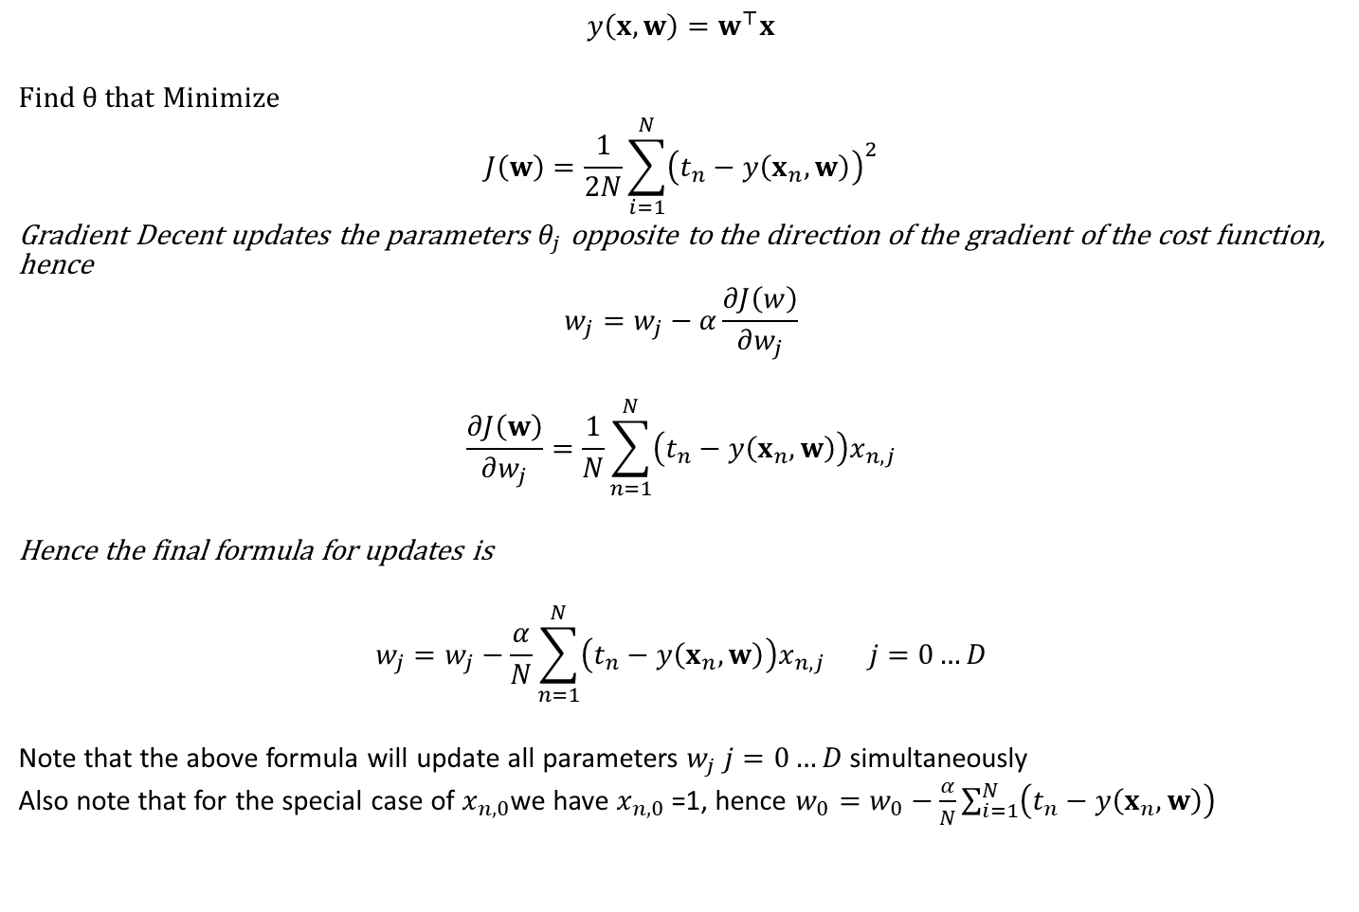
Linear Regression Gradient Decent
$$y\left(x,w\right)=w^{⊤}x$$
Find $θ$that Minimize
$$J\left(w\right)=\frac{1}{2N}\sum_{i=1}^{N}{{\left(t_{n}−y\left(x_{n},w\right)\right)}^{2}}$$
Gradient Decent updates the parameters $θ_{j}$ opposite to the direction of the gradient of the cost function, hence
$$w_{j}=w_{j}−α\frac{∂J\left(w\right)}{∂w_{j}}$$
$$\frac{∂J\left(w\right)}{∂w_{j}}=\frac{1}{N}\sum_{n=1}^{N}{\left(t_{n}−y\left(x_{n},w\right)\right)x_{n,j}}$$
Hence the final formula for updates is
$$w_{j}=w_{j}−\frac{α}{N}\sum_{n=1}^{N}{\left(t_{n}−y\left(x_{n},w\right)\right)x_{n,j}} j=0…D$$
Note that the above formula will update all parameters $w_{j}$ $j=0…D$ simultaneously
Also note that for the special case of $x_{n,0}$we have $x_{n,0}$ =1, hence $w_{0}=w_{0}−\frac{α}{N}\sum_{i=1}^{N}{\left(t_{n}−y\left(x_{n},w\right)\right)}$

Slide 19
Linear Regression and Nonlinearity
We have assumed so far that the model function that we are trying to build take the form of a linear function
This is quite a strong and restricted assumption to make
What about if the model is nonlinear?

Slide 20
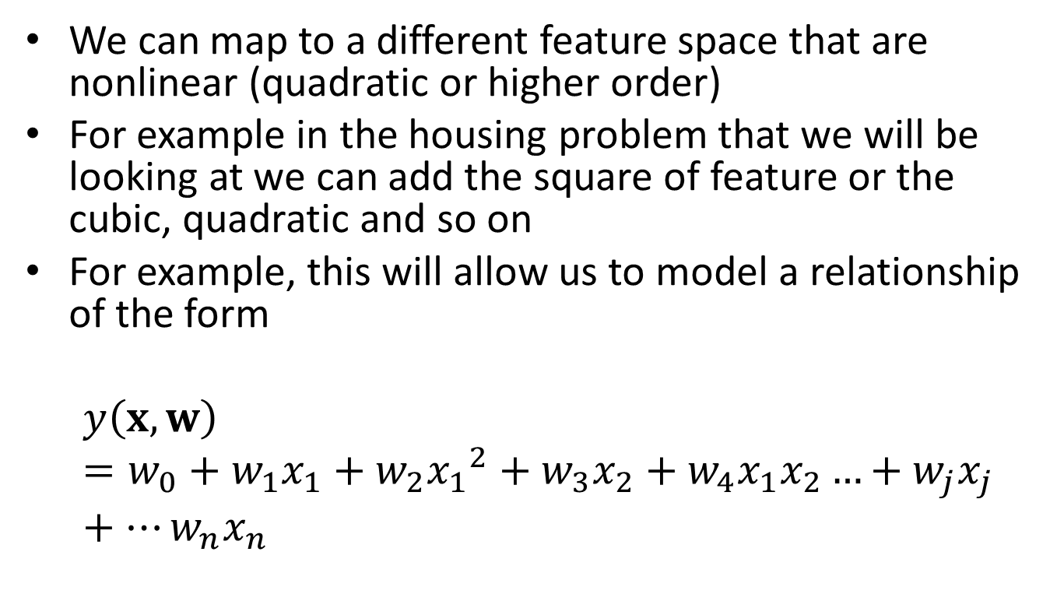
Nonlinearity: Feature Space
We can map to a different feature space that are nonlinear (quadratic or higher order)
For example in the housing problem that we will be looking at we can add the square of feature or the cubic, quadratic and so on
For example, this will allow us to model a relationship of the form
$$y\left(x,w\right)=w_{0}+w_{1}x_{1}+w_{2}{x_{1}}^{2}+w_{3}x_{2}+w_{4}x_{1}x_{2}…+w_{j}x_{j}+…w_{n}x_{n}$$

Slide 21
Nonlinearity
Another direction to pursue is to change the nature of the hypothesis itself
This what we will be doing in Logistics Regression (LogReg)
However be aware that LogReg is used for classification not for prediction!

Slide 22
Logistic Regression
In the next lecture we will be developing a new type of model that raise our abilities to model binary relationships

Slide 23
Features Transformation
Issues

Slide 24
Types of normalisation
What is normalisation
Simply normalisation is the process of restricting the range of values that a feature can take to a specific bound
often [0, 1] or [-1 , 1]
Why ?
Because such range will set balance between features and prevent overly big value features to take over unnecessary
Still why?
Because some features could have small values but have bigger effect on the model than other features

Slide 25
Types of normalisation
Ok give us and example
Ok for example in housing the number of bedrooms (1,2, 3…) is often much smaller that square foot but it could be more important

Slide 26
Scaling
Scaling: We can either look locally to the dataset itself and get the current max of a feature then
If a feature value is 6 and the min is 5 and max is 10 then 6 can be looked at scoring 1 out of five?
(6-5)/(10-5)= 1/5 or more generally
Normalied_val = (val-min)/(max-min)

Slide 27
Normalisation: Standardisation
Standardisation: Or we can take a more sophisticated approach by fitting a normal distribution on the feature. This is a presumption but works well for most of the cases
Normalised_val = (val-mean(vals))/std(vals)
By applying the above we get a feature with a mean of 0 and standard deviation of 1

Slide 28
Normalisation: Scaling to unit length
Scaling to unit length: we can look at multiple features at the same time and deal with them as a whole in terms of a vector: hence we can divide by the length of the vector or the Euclidean length of the vector:
Normalied_val =val/(val1^2 + val2^2)

Slide 29
Overfitting, cross validation and regularisation
Issues

Slide 30
Overfitting!!
Occurs due to: Trying to generate a model that perfectly fits the training set (by excessive training)
The model learns to represent even the noise in the data!
This normally means that the model generalisation capability is sacrificed
For the sack of excessively reducing the cost function for the training data set.
It makes us feel better when we look at the training phase
But in reality it degrades the model capabilities with other data

Slide 31




Overfitting example
$$t_{n}$$
$$t_{n}$$
$$y(x_{n},w)$$
$$y(x_{n},w)$$
Good training and generalisation
Overfitting: because of excessive training

Slide 32


Underfitting example
$$t_{n}$$
$$t_{n}$$
$$y(x_{n},w)$$
$$y(x_{n},w)$$
Good training and generalisation
Underfitting: because of not enough training

Slide 33
?
So how we can prevent or fight overfitting?

Slide 34
Cross Validation- Holdout
When few models are trained using a training set
Their generalisation performance can be measured against a validation set
(that they have not seen before) and
we can pick the best of model (sets of parameters)
It is the model that minimizes the cost function the most for a data that has not been seen by the models before (that is the validation set)
This process is called cross validation, holdout method.
The testing set is preserved to give a generalisation measure of the chosen model on yet another new set that it has not come across it before.

Slide 35
K-fold Cross Validation
The previous method of holding out a validation or test set is prone to high variation due to the way we divided our data and which data went to which set (validation set, test set and training set)
A more stable and less variant method is to do a 10-fold or K-fold cross validation which we covered fully in unit2
Here is a reminder
In this method each time a 10% of the data is left out and the model is trained for the rest then the performance is measured against the validation set.
Then another 10% of the data is left out and the model is trained using the 90% of the data and performance is measured against the 10% validation set.
So on… until we have measured the performance of our model against all of our data in 10 folds
The final error is measured as the average of the error in all of the 10 folds
For K-folds replace the 10 by K so we make K subsets and we holdout each time one of the subsets and train using the rest, then we take the average of the errors

Slide 36
Types of sub datasets
Training set
Validation set
Testing set
Can you give a definition for each?

Slide 37
Is there a Better Solution
Training several models can be time consuming
And it seems we are applying a trial and error approach with the cross validation
Is there another easier way to get rid of overfitting?

Slide 38
?
Ideally we would like to go directly to the model and train it once and should be guaranteed that it prevent overfitting
What level or function we are aiming for?

Slide 39
Overfitting and Cost function
Yes we aim for the cost function itself
Ok so we need to find a term that if we include it in our cost function it will prevent overfitting
i.e. prevents changes to the parameters!
i.e. penalise the excessive changes for the parameters
i.e. fights the goal of learning!
This sounds strange?

Slide 40
Overfitting and Regularisation
If we think about it, the process resembles a regularisation bodies
They try to regularise a market
Ex.: real estate, by introducing
taxation and
regulations
to prevent excessive increase of market due to stock jobbing (noise in our terms) etc. which create bubble

Slide 41
Ok please tell us how to regularise
So in terms of Logistic Regression and Learning in general
How we can apply regularisation?

Slide 42
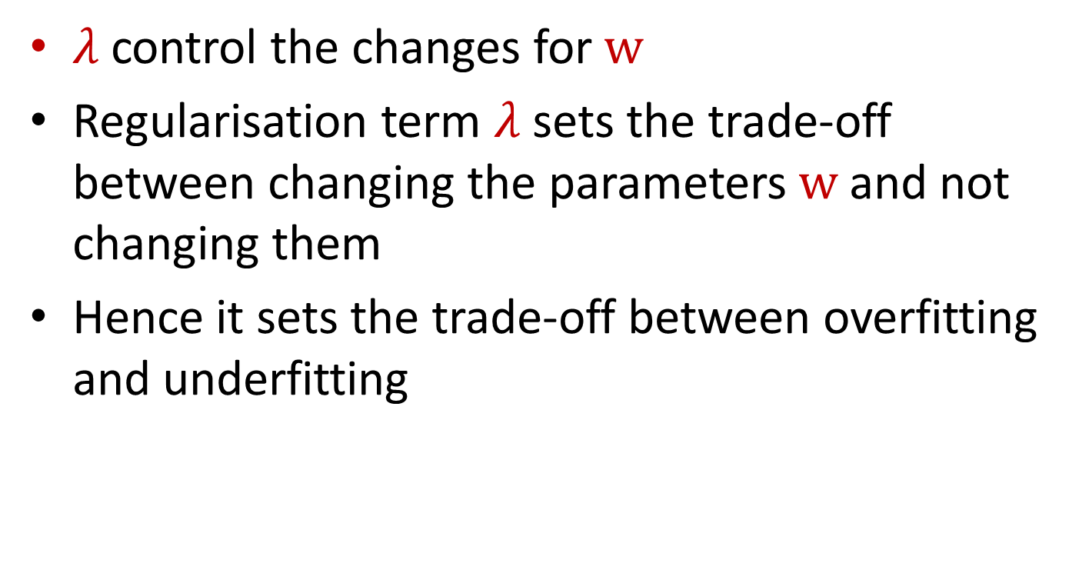
Regularisation
$λ$control the changes for $w$
Regularisation term $λ$sets the trade-off between changing the parameters $w$and not changing them
Hence it sets the trade-off between overfitting and underfitting

Slide 43
Overfitting!!
Summary:
Logistic regression needs one extra important change
In many situations when we overstrain our model to further reduce the error or the cost function for our data we fall in the overfitting trap
Overfitting occurs when our model becomes very good at predicting the results for our training data but has a poor performance for other data that it has not seen before
i.e. it has poor generalisation abilities
To prevent this situation we need to add a term to our cost function so that it strike a balance between changing the weights and not changing them too much for the particulars of our training model

